Slide 1



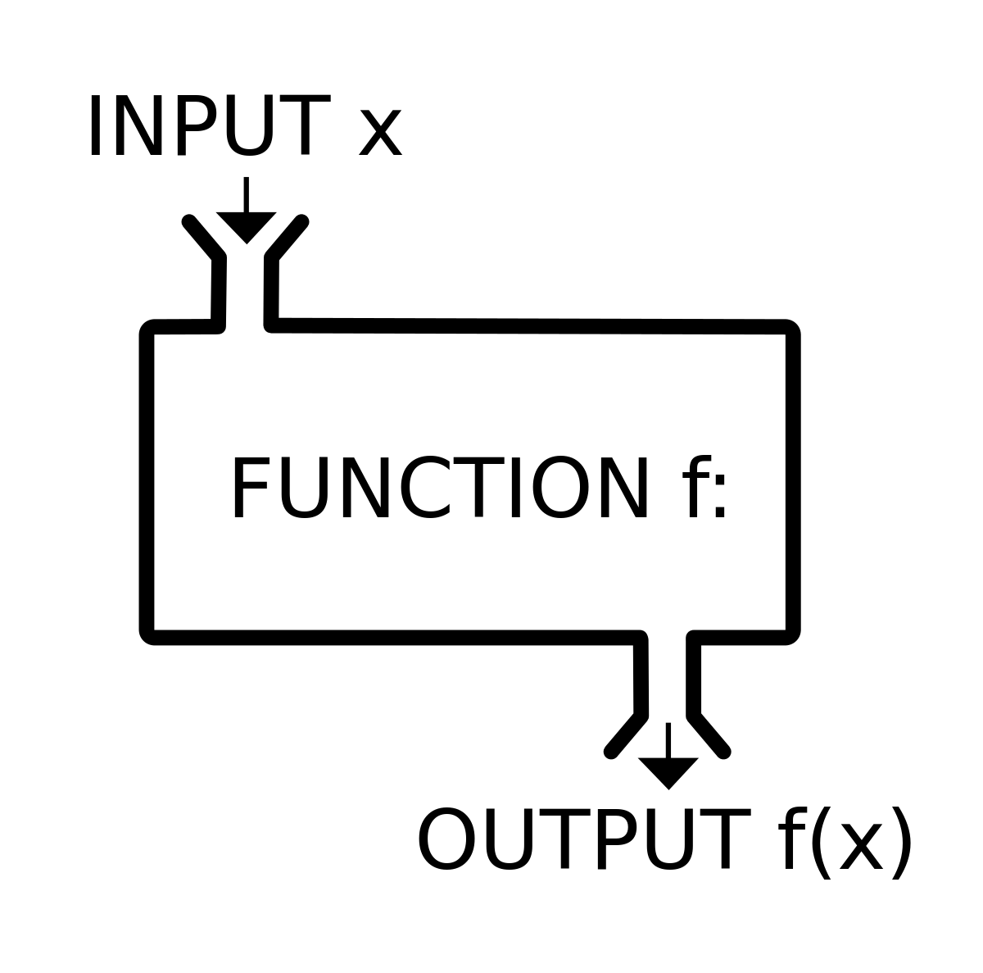
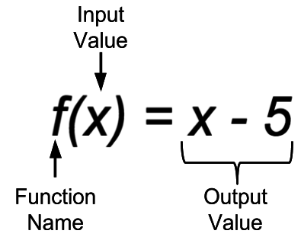

Slide 2
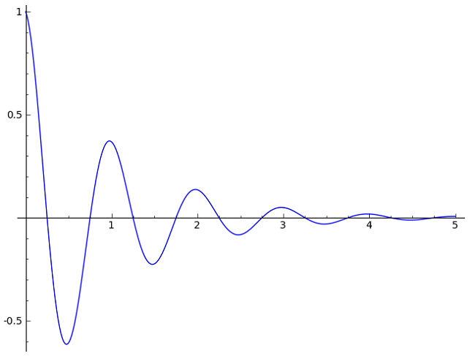
Learning goal:
By the end of you are able to identify the following concept:
Types of relations:
Functions
Range and domain of a function:

Slide 3
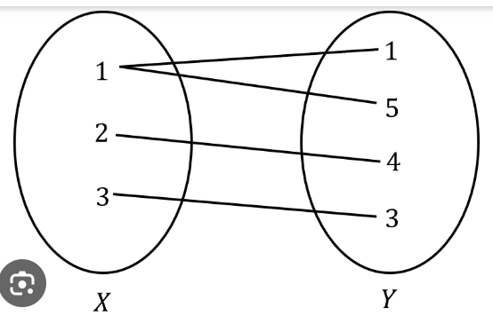

VOCABULARY
RELATION: A relation is a set of ordered pairs.
DOMAIN: The domain of a relation is the set of all inputs.
RANGE: The range of a relation is the set of all outputs.

Slide 4
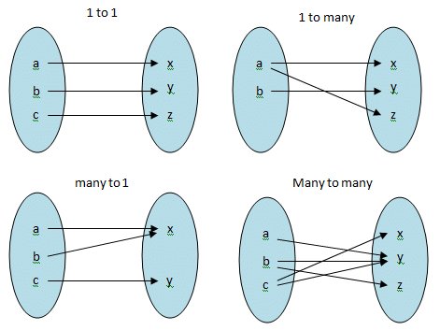
Types of relations

Slide 5
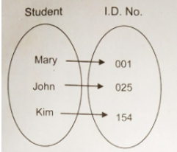
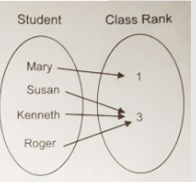
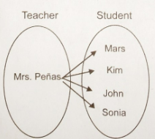
Functions.
Relations which are one-to-one or many-to-one are called functions. That is, a function is a relation where for any x-value there is only one y-value.
Worked example:
Determine which of the following relation is a function and why?
c)
d)
d)

Slide 6
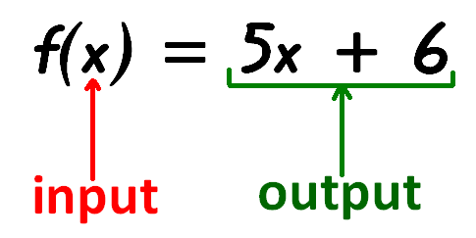
Function notation
Functions are usually denoted with lowercase letters such as f , g, h.

Slide 7
Worked Example 2:
For each of the following relation, state the domain and range, and whether the relation is a function or not.

Slide 8
Interval notation
Interval notation is a way to describe continuous sets of real numbers by the numbers that bound them.

Slide 9
Set notation

Slide 10
